Slide 1
Module 8.7
Filtering network traffic
(starting at IP, transport layer …)

Slide 2
Basic Firewall Concept
Perimeter security
Separate local area net from The internet
Firewall
Local network
Internet
Router
All packets between LAN and internet routed through firewall

Slide 3
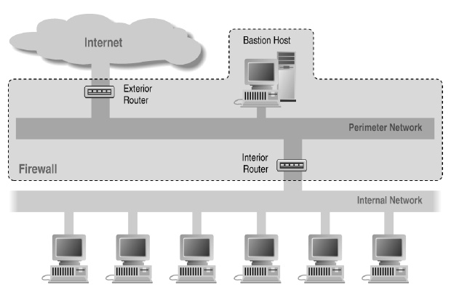
Screened Subnet Using Two Routers

Slide 4
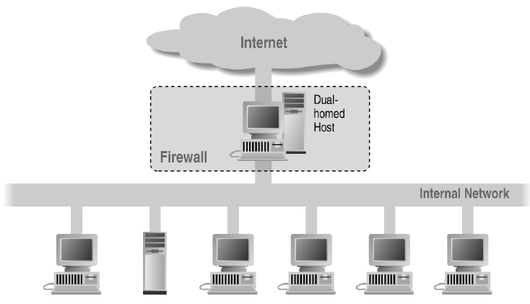
Alternate 1: Dual-Homed Host

Slide 5
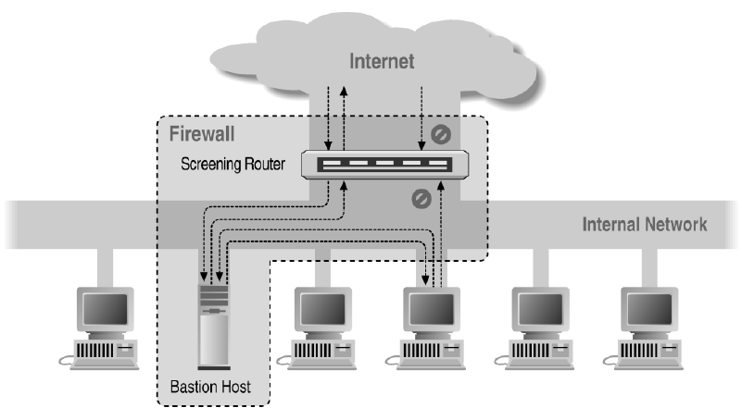
Alternate 2: Screened Host

Slide 6
Basic Packet Filtering
Uses transport-layer information only
IP Source Address, Destination Address
Protocol (TCP, UDP, ICMP, etc)
TCP or UDP source & destination ports
TCP Flags (SYN, ACK, FIN, RST, PSH, etc)
ICMP message type
Examples
DNS uses port 53
Block incoming port 53 packets except known trusted servers
Issues
Stateful filtering
Encapsulation: address translation, other complications
Fragmentation

Slide 7
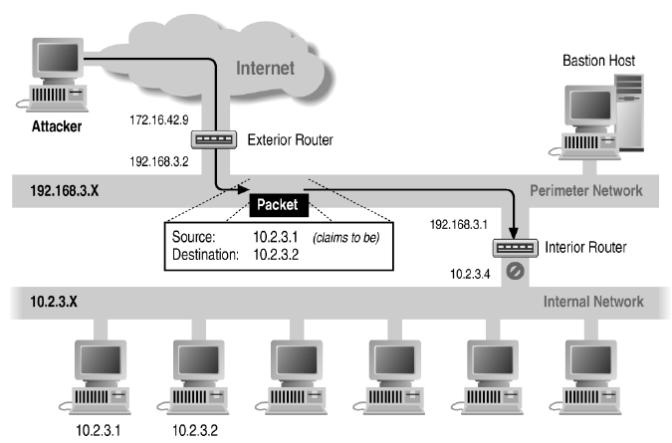
Source/Destination Address Forgery

Slide 8
More about networking: port numbering
TCP connection
Server port uses number less than 1024
Client port uses number between 1024 and 16383
Permanent assignment
Ports <1024 assigned permanently
20,21 for FTP 23 for Telnet
25 for server SMTP 80 for HTTP
Variable use
Ports >1024 must be available for client to make connection
Limitation for stateless packet filtering
If client wants port 2048, firewall must allow incoming traffic
Better: stateful filtering knows outgoing requests
Only allow incoming traffic on high port to a machine that has initiated an outgoing request on low port

Slide 9
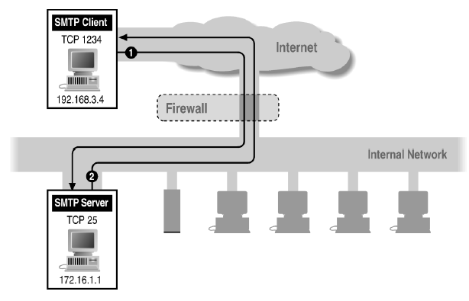
Filtering Example: Inbound SMTP
Can block external request to internal server based on port number

Slide 10
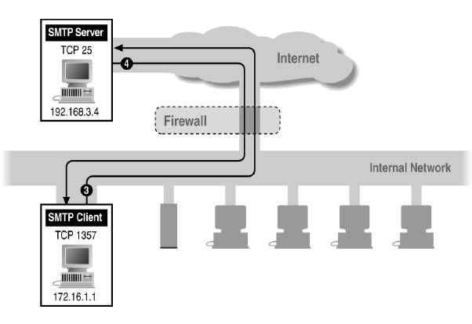
Filtering Example: Outbound SMTP
Known low port out, arbitrary high port in
If firewall blocks incoming port 1357 traffic then connection fails

Slide 11
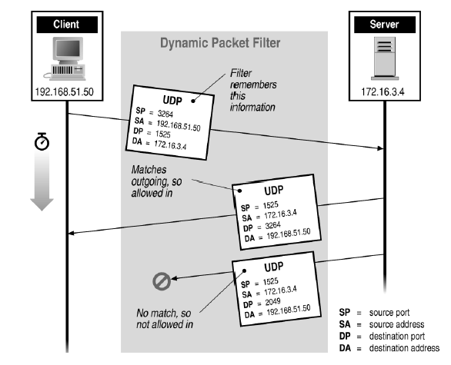
Stateful or Dynamic Packet Filtering

Slide 12
Telnet
Telnet Server
Telnet Client
◆ Client opens channel to server; tells server its port number. The ACK bit is not set while establishing the connection but will be set on the remaining packets
23
1234
◆
“PORT 1234”
❖
“ACK”
❖ Server acknowledges
Stateful filtering can use this pattern to identify legitimate sessions

Slide 13
FTP
FTP Server
FTP Client
◆ Client opens command channel to server; tells server second port number
20
Data
21
Command
5150
5151
◆
❖ Server acknowledges
“PORT 5151”
⬥ Server opens data channel to client’s second port
❖
⬥
“OK”
DATA CHANNEL
 Client acknowledges

TCP ACK
Notes:
From Zwicky, Building Internet Firewalls, second edition page 456

Slide 14
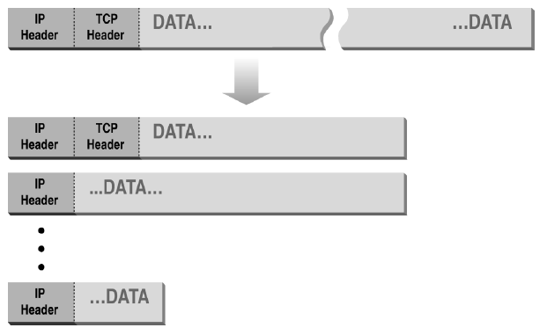
Normal IP Fragmentation
Complication for firewalls
Flags and offset inside IP header indicate packet fragmentation

Slide 15
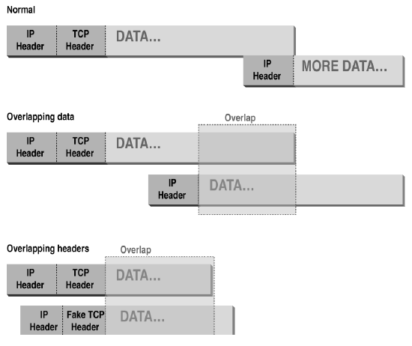
Abnormal Fragmentation
Low offset allows second packet to overwrite TCP header at receiving host

Slide 16
Packet Fragmentation Attack
Firewall configuration
TCP port 23 is blocked but SMTP port 25 is allowed
First packet
Fragmentation Offset = 0.
DF bit = 0 : "May Fragment"
MF bit = 1 : "More Fragments"
Destination Port = 25. TCP port 25 is allowed, so firewall allows packet
Second packet
Fragmentation Offset = 1: second packet overwrites all but first 8 bits of the first packet
DF bit = 0 : "May Fragment"
MF bit = 0 : "Last Fragment."
Destination Port = 23. Normally be blocked, but sneaks by!
What happens
Firewall ignores second packet “TCP header” because it is fragment of first
At host, packet reassembled and received at port 23

Slide 17
TCP Protocol Stack
Application protocol
Application
Application
Transport
TCP protocol
Transport
Network
IP protocol
IP
IP protocol
Network
Link
Data Link
Network Access
Data Link
Link

Slide 18
Remember SSL/TLS
Version, Crypto choice, nonce
S
C
Version, Choice, nonce,
Signed certificate
containing server’s
public key Ks
Secret key K
encrypted with
server’s key Ks
switch to negotiated cipher
Hash of sequence of messages
Hash of sequence of messages
data transmission

Slide 19
Proxying Firewall
Beyond packet filtering
Application-level proxies
Tailored to http, ftp, smtp, etc.
Some protocols easier to proxy than others
Policy embedded in proxy programs
Proxies filter incoming, outgoing packets
Reconstruct application-layer messages
Can filter specific application-layer commands, etc.
Example: only allow specific ftp commands
Other examples: ?
Several network locations – see next slides

Slide 20
Firewall with application proxies
FTP proxy
Telnet proxy
SMTP proxy
Telnet daemon
FTP daemon
SMTP daemon
Network Connection
Daemon spawns proxy when communication detected …

Slide 21
Application-level proxies
Enforce policy for specific protocols
E.g., Virus scanning for SMTP
Need to understand MIME, encoding, Zip archives
Flexible approach, but may introduce network delays
“Batch” protocols are natural to proxy
SMTP (E-Mail) NNTP (Net news)
DNS (Domain Name System) NTP (Network Time Protocol
Must protect host running protocol stack
Disable all non-required services; keep it simple
Install/modify services you want
Run security audit to establish baseline
Be prepared for the system to be compromised

Slide 22
Web traffic scanning
Intercept and proxy web traffic
Can be host-based
Usually at enterprise gateway
Block known bad sites
Block pages with known attacks
Scan attachments
Usually traditional virus scanning methods

Slide 23
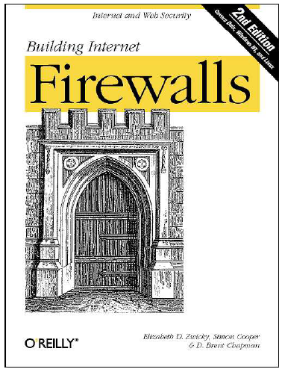
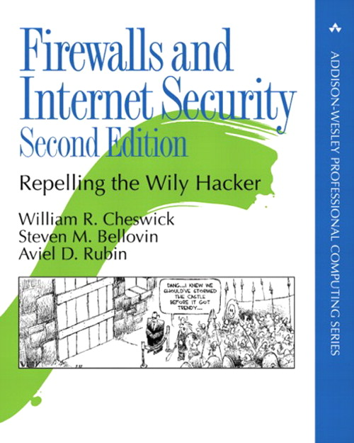
Firewall references
Elizabeth D. Zwicky
Simon Cooper
D. Brent Chapman
William R Cheswick
Steven M Bellovin
Aviel D Rubin

